Slide 1
Where’s the hacker spirit?
Matthieu Villatte, PhD

Slide 2
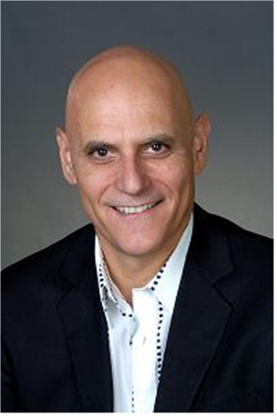
“Geeks need a sand box -- not just a soap box”
-- Steve H.

Slide 3
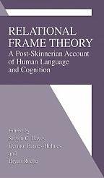
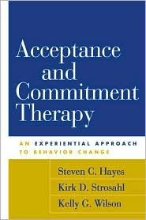
From behavioral principles to ACT
NOT GOOD ENOUGH
TOO COMPLICATED
WILL DO

Slide 4
Behavioral principles
The dissemination strategy
Get out of your mind and into your life!
Control is the problem!
Watch out for making sense and problem solving!
Reduce verbal dominance!
Middle level terms

Slide 5
Has ACT become a local adaptive peak?

Slide 6
Restoring the hacker spirit in ACT
Hacker:
Enjoys the intellectual challenge of creatively overcoming and circumventing limitations of programming systems and who tries to extend their capabilities.

Slide 7
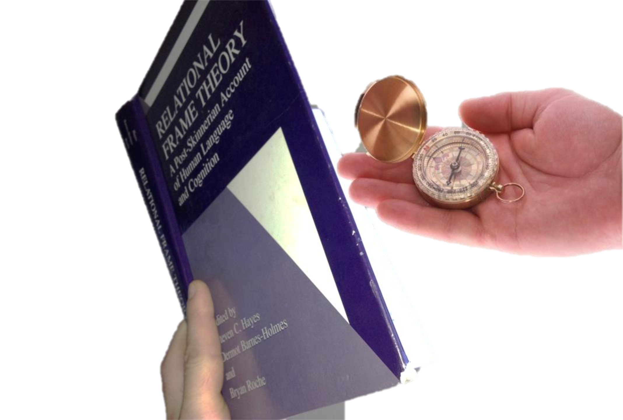

Slide 8
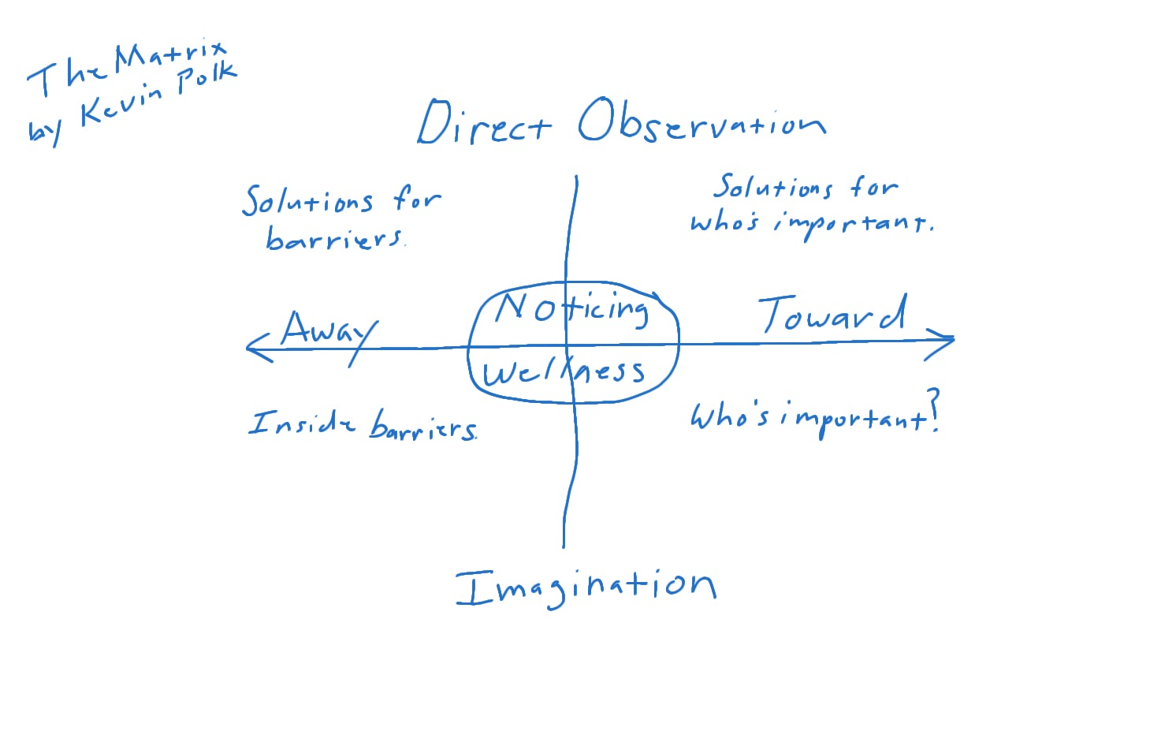
One example

Slide 9
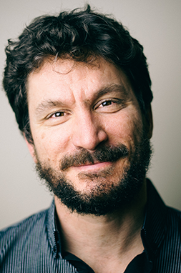
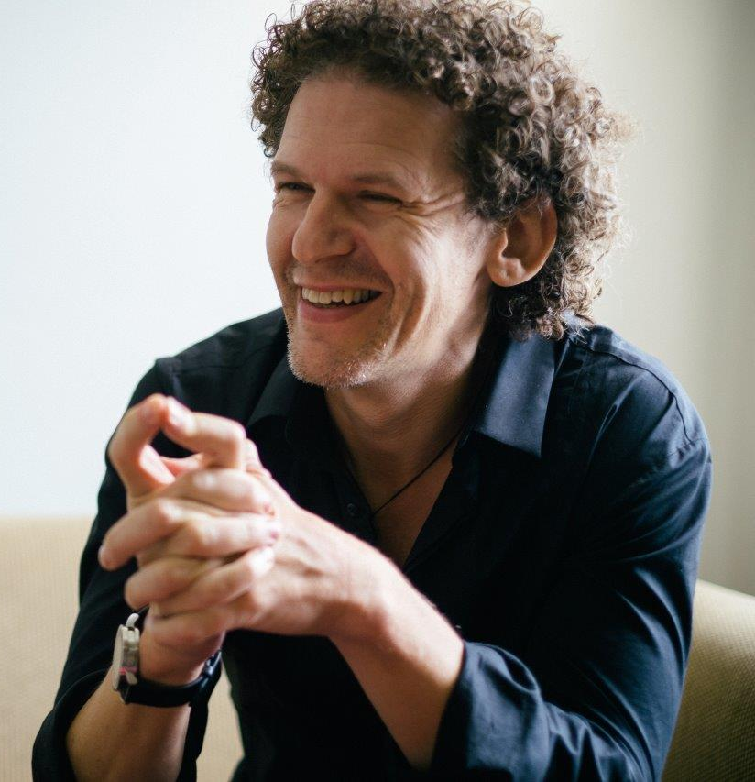
“Experiential avoidance is not always A problem, is not always THE problem, and is not always THE ONLY problem.”

Slide 10
Hacking the matrix
VALUES
Mental
Mental
AVOIDANCE
APPROACH
External
External

Slide 11
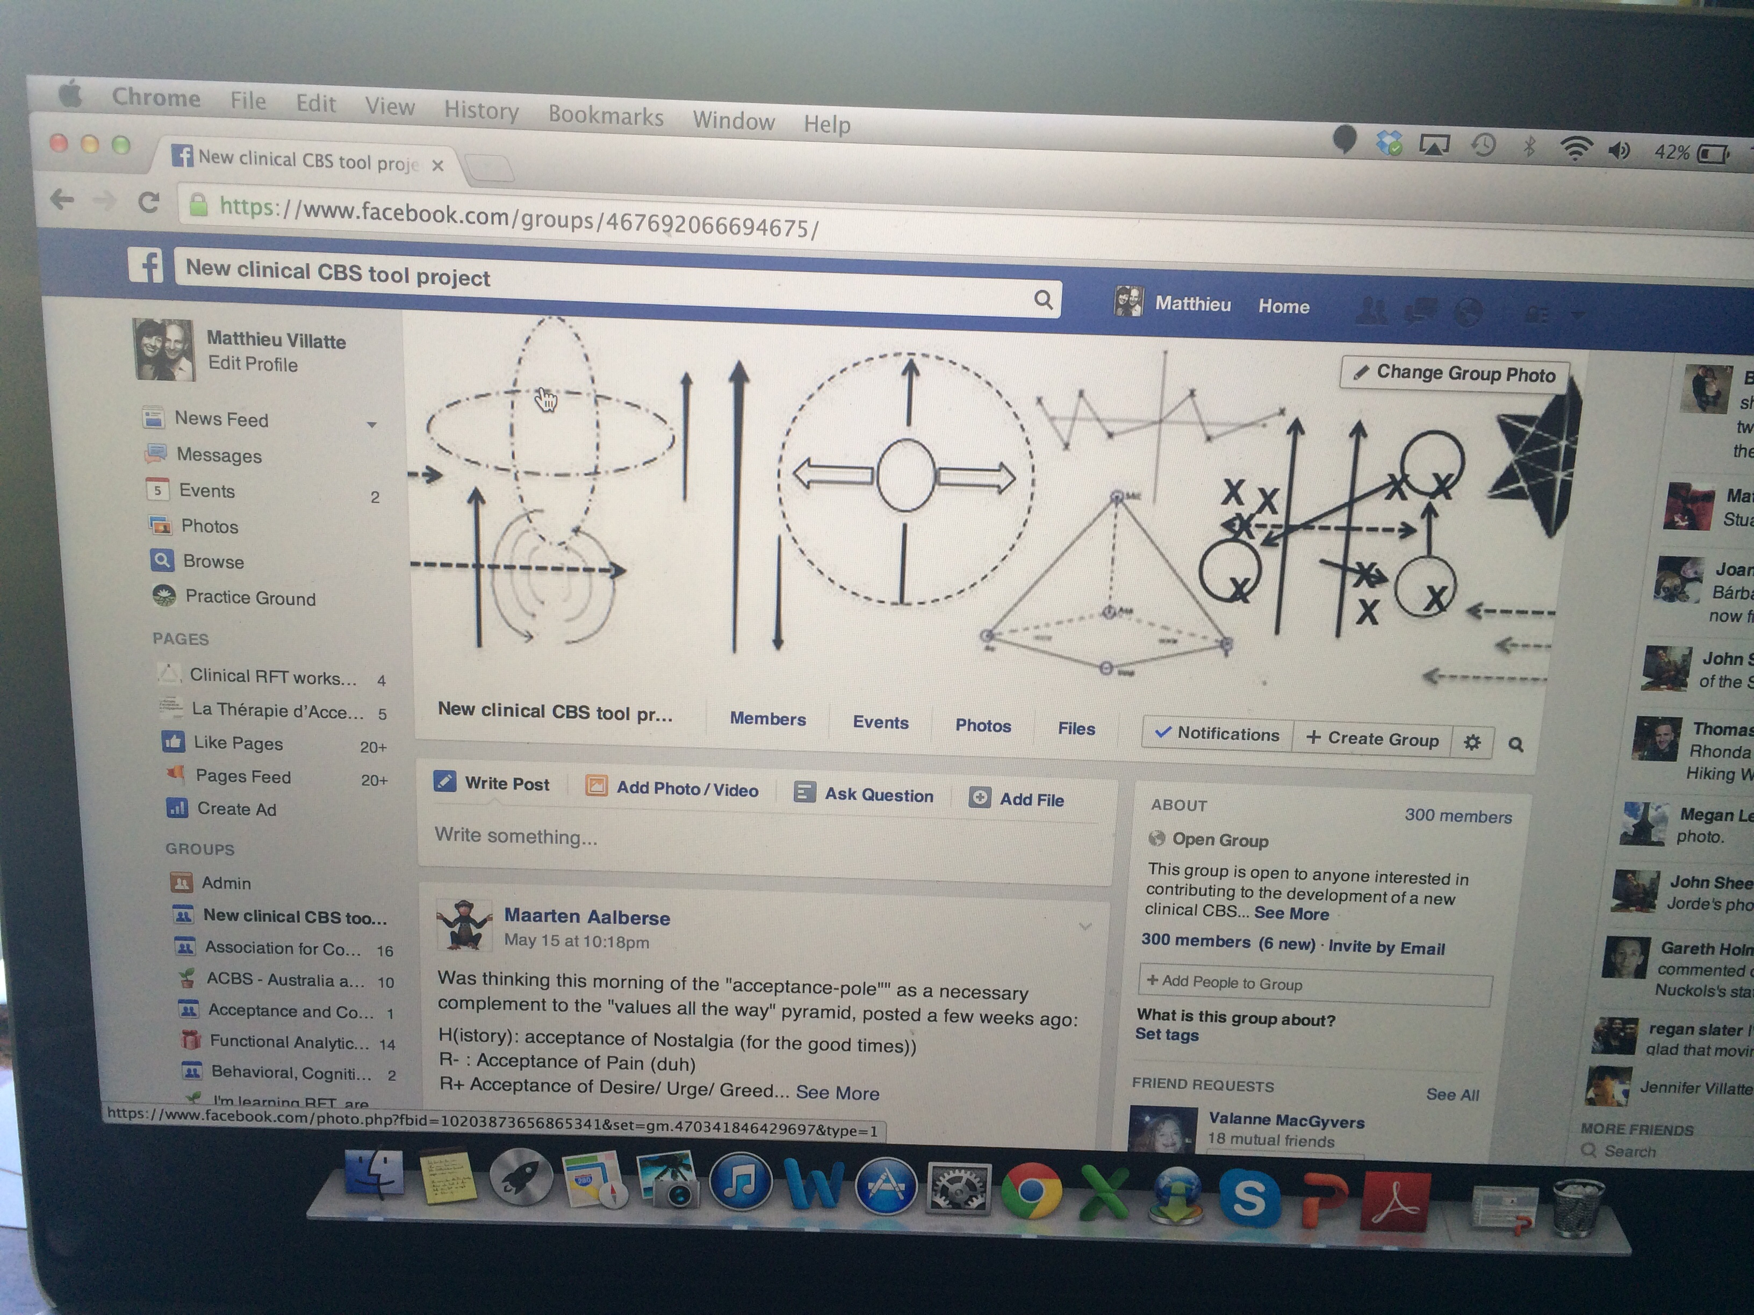
A community of 300 hackers

Slide 12
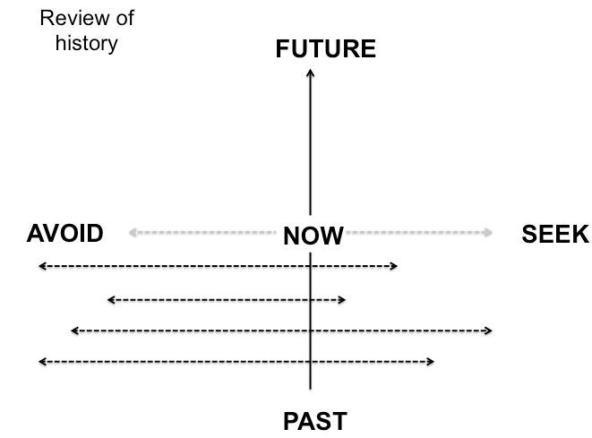
Playing around…

Slide 13
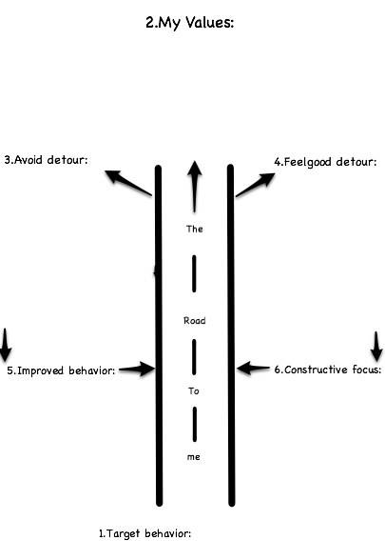
Exploring further…

Slide 14
And further…

Slide 15
Getting more and more creative…
(and slightly crazy)

Slide 16
And having fun.

Slide 17
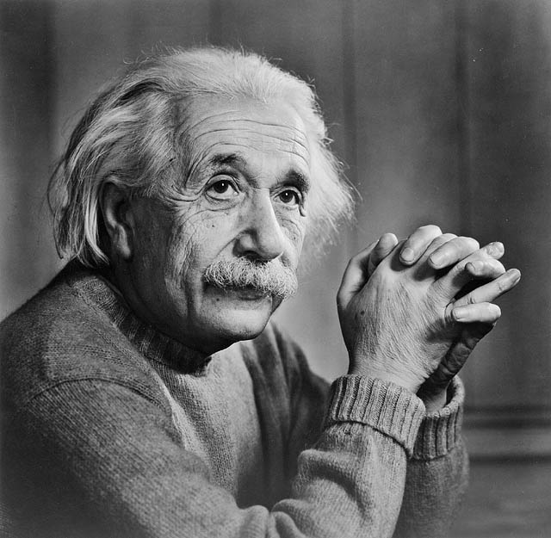
“Everything should be made as simple as possible,
but not simpler”

